Slide 1
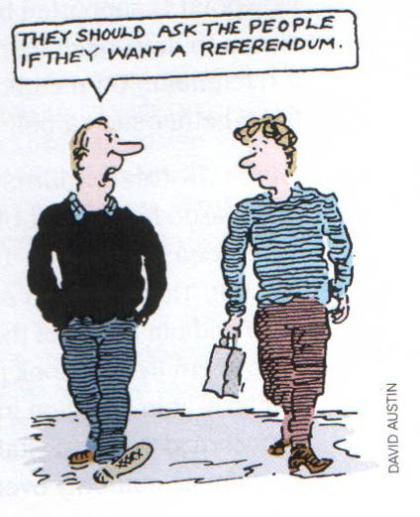

Referendums
What is a referendum?

Slide 2

Referendum
It is a direct vote in which an entire electorate is asked to either accept or reject a particular proposal.

Slide 3
Referendums in Australia
1973, Northern Ireland – govt. did not agree to be bound by results
1975, membership of EU –criticism over wording of question, debate favoured govt view
1979, devolution Scotland & Wales – 40%+ support of electorate
1997, devolution for Scotland and Wales – Labour had a manifesto commitment to devolution, no threshold required, two different questions in Scot. & Wales

Slide 4
UK referendums
1998, Northern Ireland – intended to gather support for Peace Process above the heads of troublesome political leaders in NI
1998, London Mayor – positive result, low turnout (45%)
2004, regional assembly, NE – decisive ‘No’ (78%)
Single currency / EU constitution – promised referendums
May 2011??? Electoral reform

Slide 5
Arguments put forward in favour of referendums are:
1. They are a very real form of direct democracy
2. They increase political participation
3. Referendums provide a clear answer to a question the government might be 'asking'.
4. Referendums allow voters to voice an opinion on a major issue.
5. Referendums can unite a divided party.

Slide 6
Arguments put forward against the use of referendums are:
1. Referendums are inconsistent with the belief in parliamentary sovereignty.
2. Issues might be too complex for a mere yes/no vote or for the public to understand.
3. There are effective alternatives : opinion polls and by-elections.
4. Can be expensive to the tax payers.

Slide 7
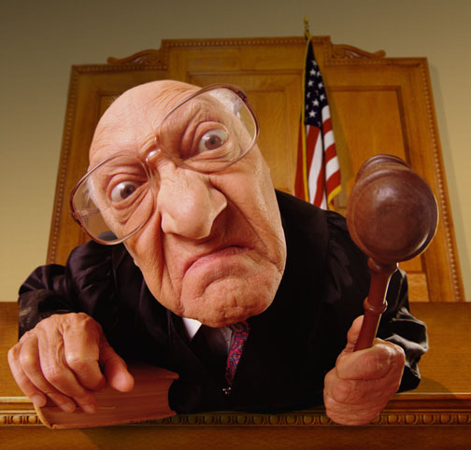
Referendums improve the quality of the relationship between government and people’. To what extent do you agree?

Slide 8
 Plenary
Where did direct democracy begin?
Name 2 key characteristics of direct and indirect democracy
Give 3 examples of referendums held in the UK?
Give 3 advantages & 3 disadvantages of referenda

